Slide 1
Introduction to Flask
These slides are to be used in conjunction with the lab document.

Slide 2
OBJECTIVE
Turn Python program(s) into web application(s)/service(s) using Flask.

Slide 3
INTRODUCTION
Flask is a micro web framework written in Python, which can be used to build websites and web applications.
A framework is a code library/reusable code/extensions to make a developer’s life easier - https://opensource.com/article/18/4/flask
For our purpose, we use Flask to allow Python functions to be called using URLs within HTTP clients such as web browsers and especially by other applications using HTTP methods.

Slide 4
PREREQUISITES
Installed Python 3
Installed Visual Studio Code

Slide 5
LAB OUTLINE
Install Flask
Create and run a minimal Flask app

Slide 6
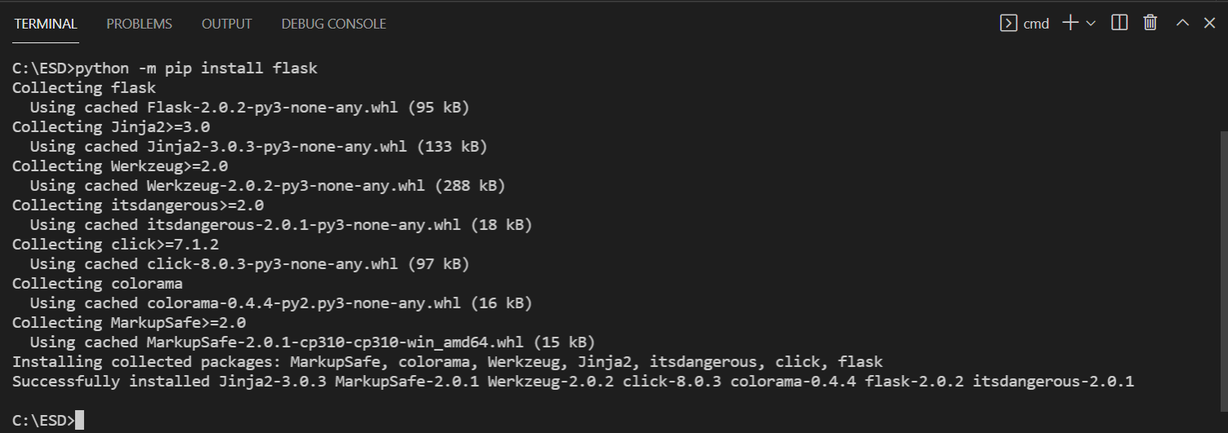
INSTALL FLASK
pip is the standard package manager for Python. It allows you to install and manage additional packages that are not part of the Python standard library - https://realpython.com/what-is-pip/
python -m pip install flask

Slide 7
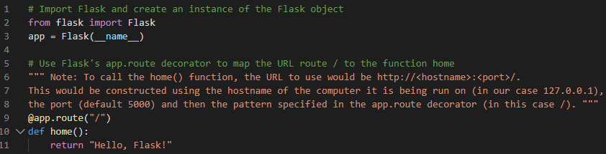
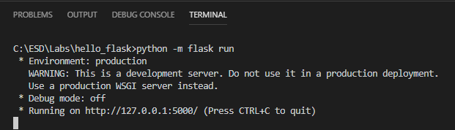
CREATE AND RUN A MINIMAL FLASK APP
app.py
python -m flask run (by default, this runs app.py)

Slide 8
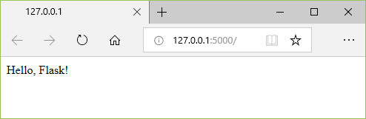
CREATE AND RUN A MINIMAL FLASK APP
http://127.0.0.1:5000/

Slide 9

ALTERNATIVE WAY TO RUN A FLASK APP
Add the following to the end of app.py
python app.py
By adding this, you allow this python script to be run from the command line by its file name, without needing to use the -m flask switch nor name it app.py. E.g. python hello.py

Slide 10
LEARNING POINTS
Installing Python package(s) such as Flask
Using Flask in Python program(s)
Mapping URL(s) to Python function(s) using app.route decorator(s)
Running Flask application(s) and calling the function(s) using a browser

